Slide 1
Populations
By: Leo Huang, Megan Colley, and Michael Becker

Slide 2
data
Data USA https://datausa.io/
Size 52 samples per year
5 years of data

Slide 3
Data(json, geojson)
Pandas/python
Javascript, leaflet, highcharts
Data(us population)
https://datausa.io/
Website(html, bootstrap, CSS)
SQL
Flask python, D3, api
Pandas/python

Slide 4
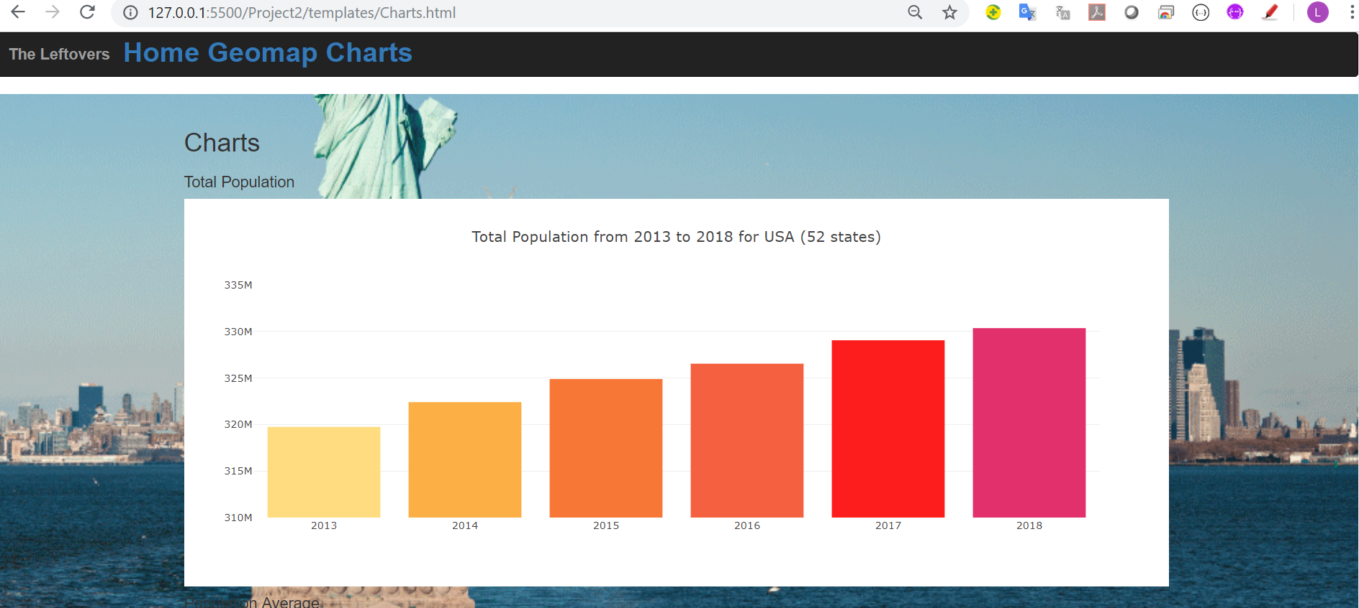

Slide 5
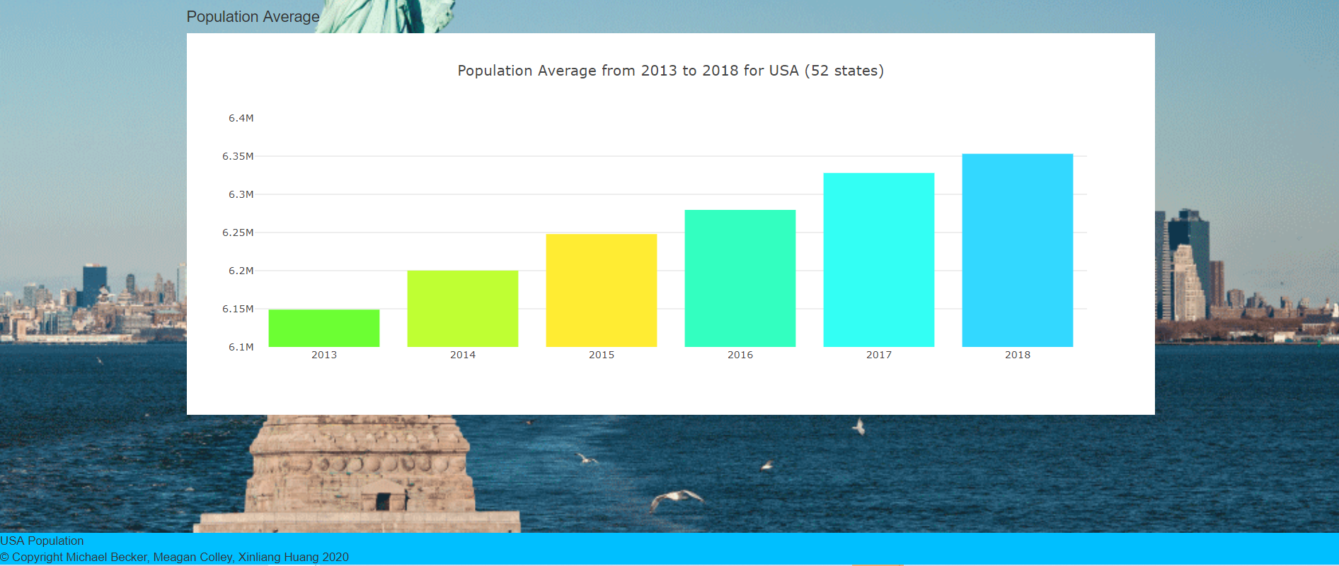

Slide 6
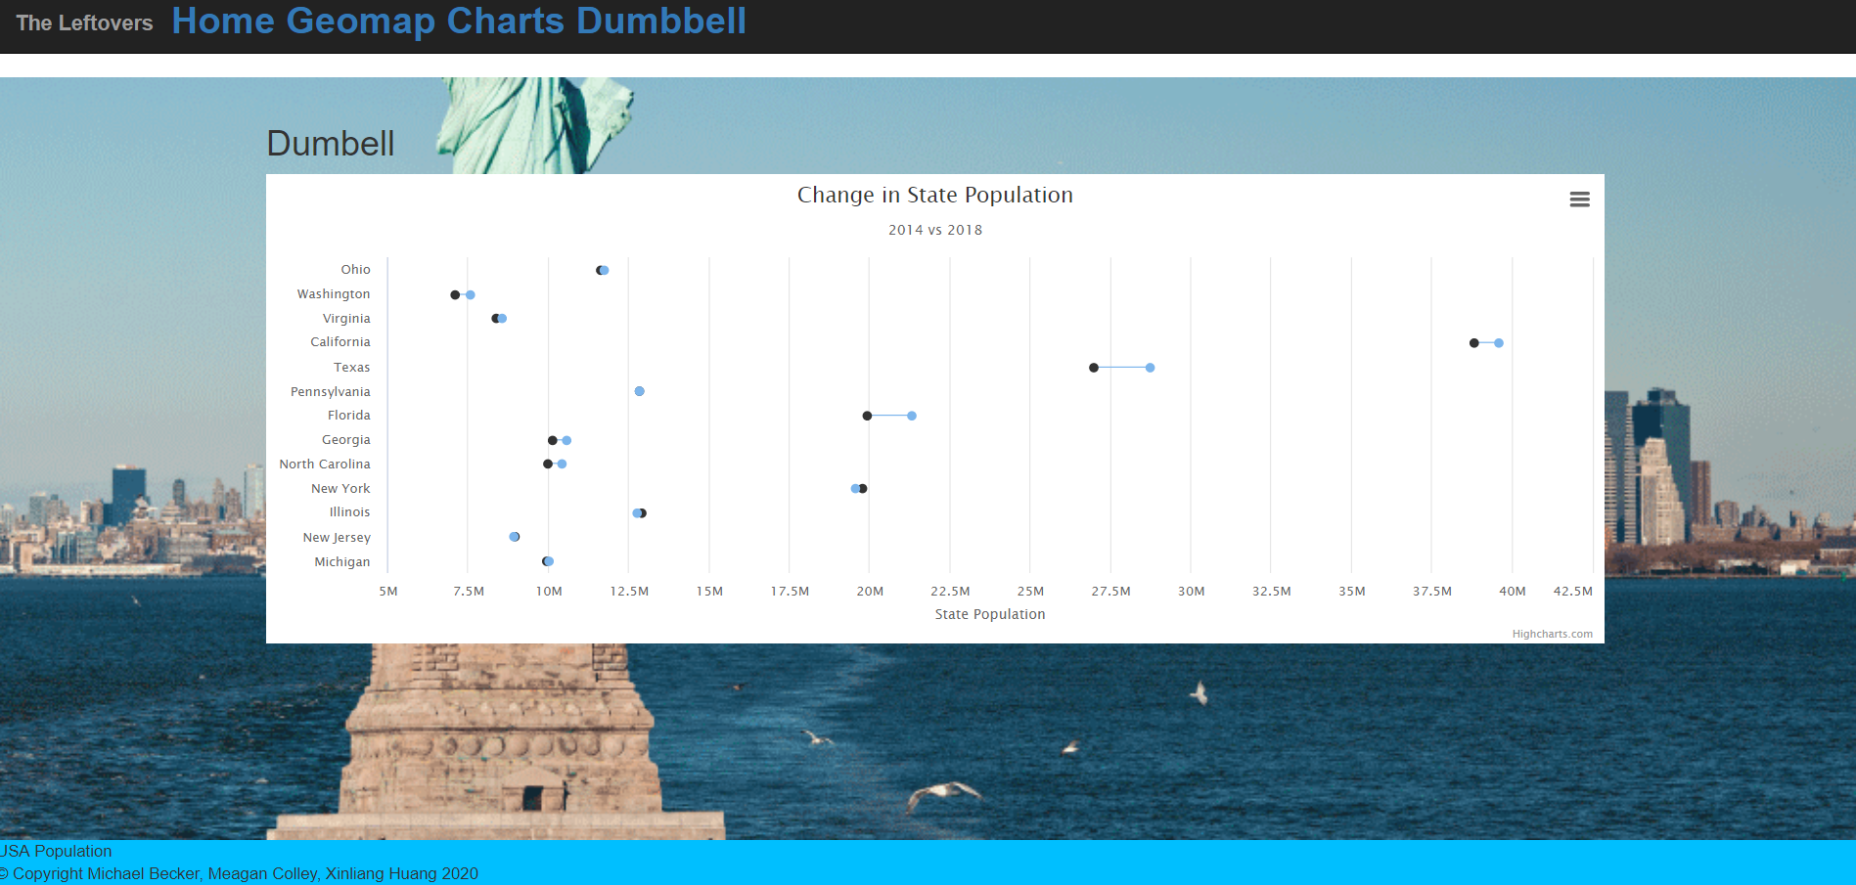

Slide 7
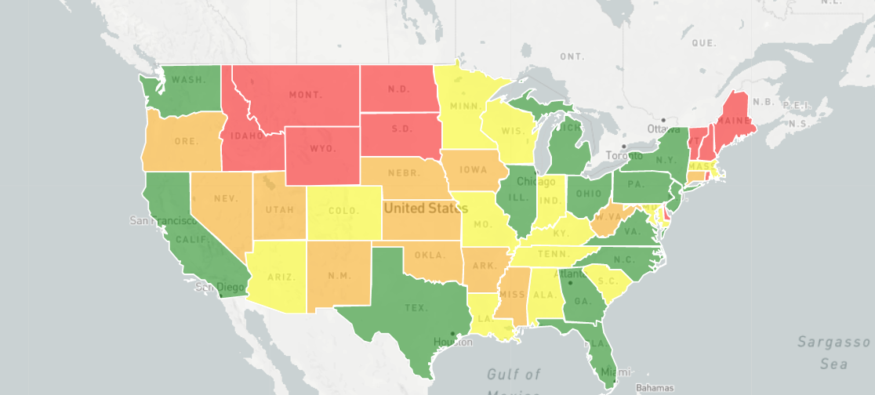

Slide 8
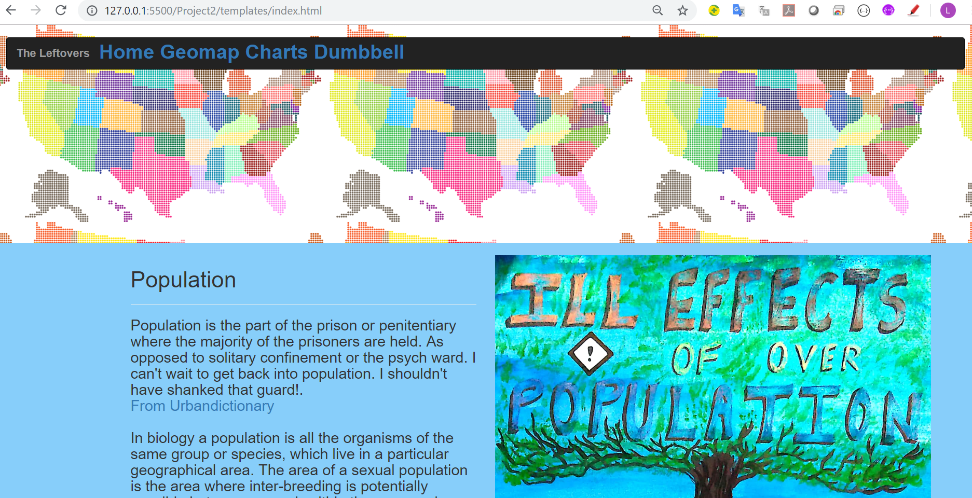
Site
Link goes here

Slide 9
Questions

